Slide 1
Climate Trends in the Corn Belt
Eugene S. Takle
Professor
Department of Agronomy
Department of Geological and Atmospheric Science
Director, Climate Science Program
Iowa State University
Ames, IA 50011
Carbon, Energy, and Climate Conference
Michigan State University W. K. Kellogg Biological Station
Hickory Corners, MI
27 September 2012

Slide 2
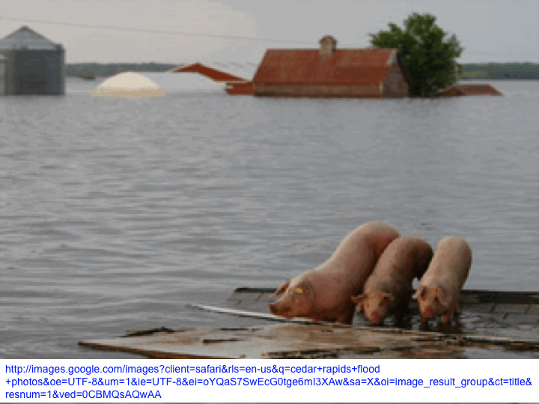
Outline
Recent changes in climate of the Midwest
Focus on extremes
Producer adaptation to climate change
Future projections of extreme precipitation

Slide 3
Iowa State-Wide Average Data

Slide 4
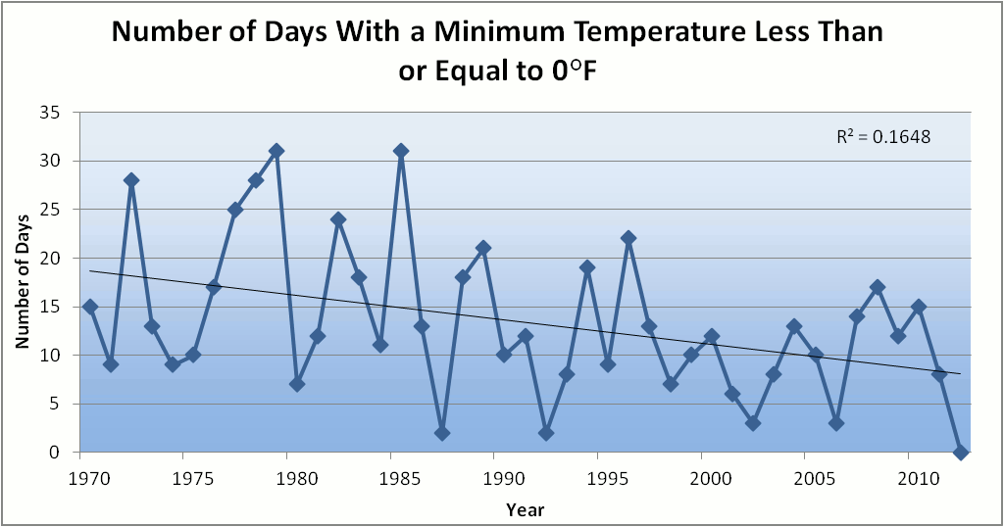
Des Moines Airport Data
Caution: Not corrected for urban heat island effects

Slide 5
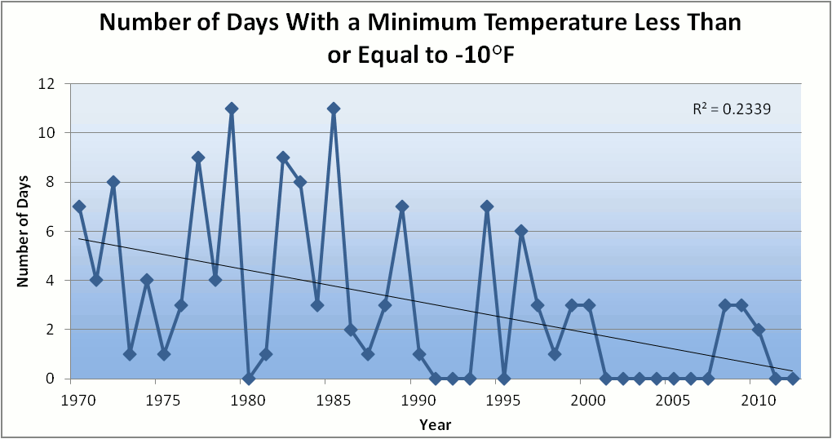
Des Moines Airport Data
Caution: Not corrected for urban heat island effects

Slide 6
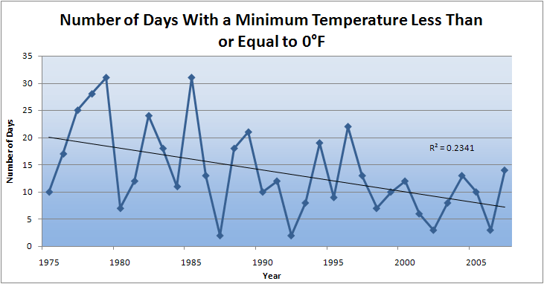
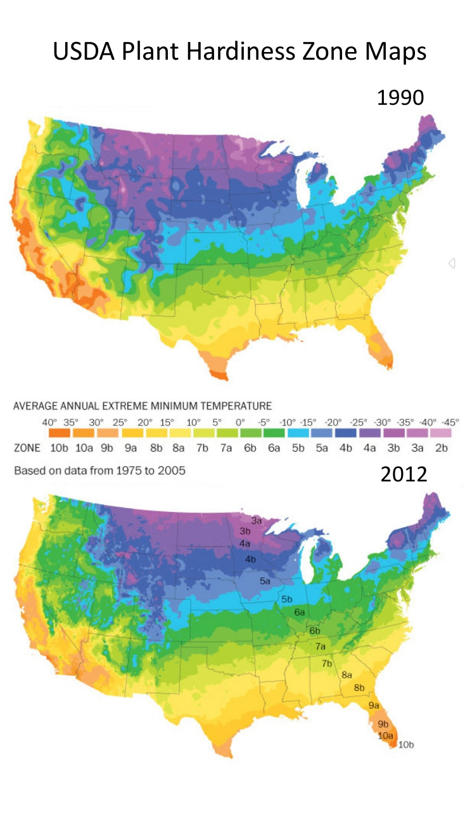
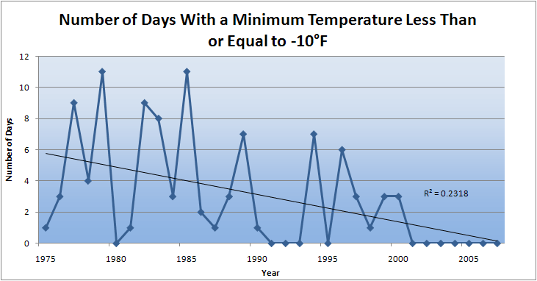
Winter Temperatures are Rising, Fewer Extreme Cold Events
Des Moines, IA
Des Moines, IA

Slide 7
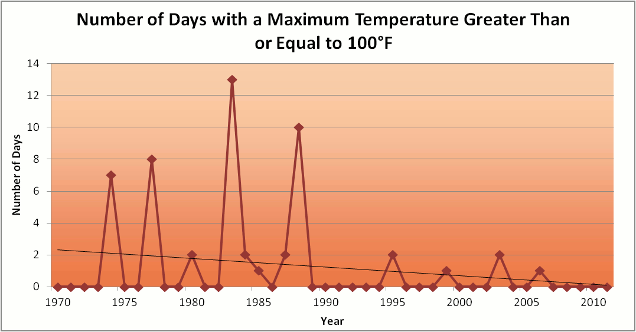
Des Moines Airport Data
1983: 13
1988: 10
1977: 8
1974: 7
6 days ≥ 100ºF in the last 23 years

Slide 8
Des Moines Airport Data
1983: 13
8 days in 2012
1988: 10
1977: 8
1974: 7
6 days ≥ 100ºF in the last 23 years

Slide 9
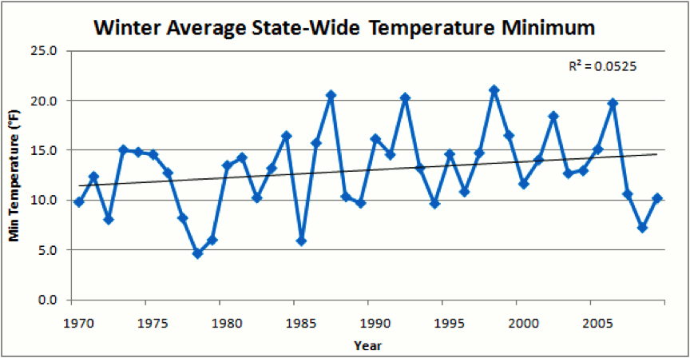
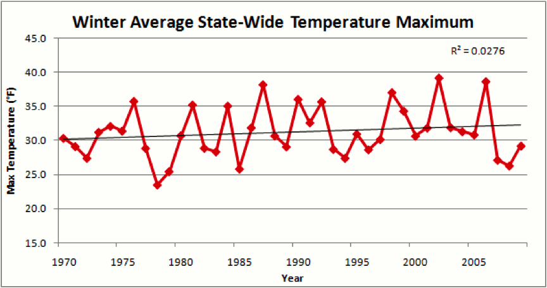
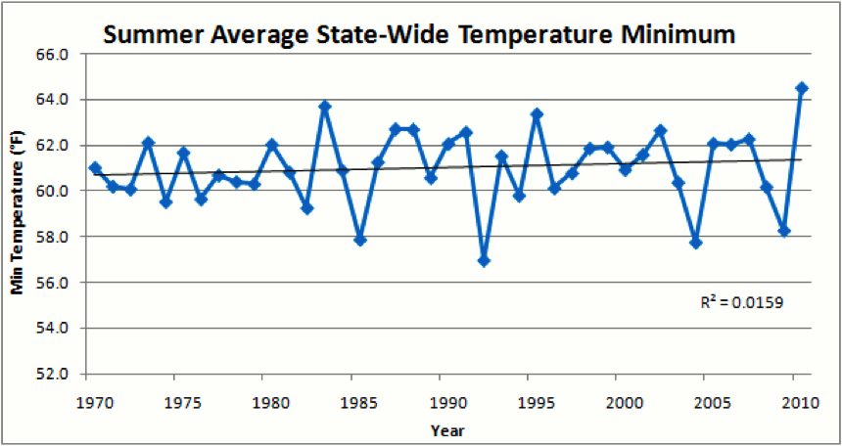
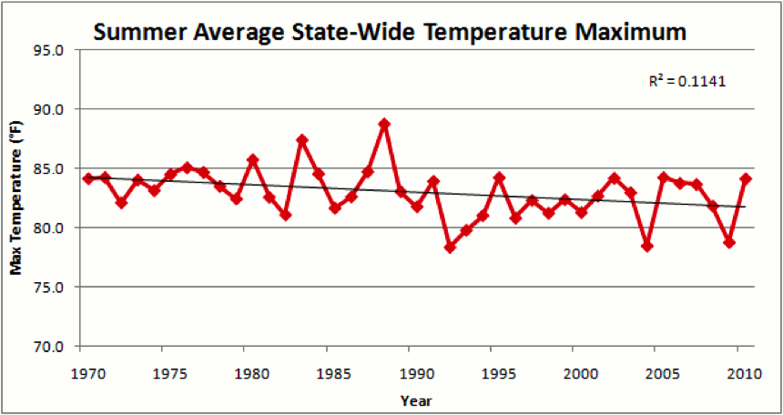

Slide 11
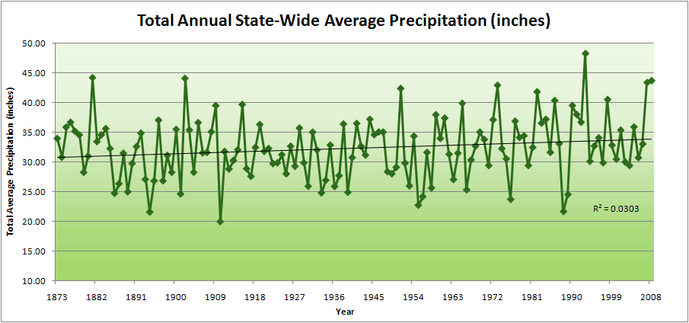
Iowa State-Wide Average Data
34.0”
10% increase
30.8”

Slide 12
Iowa State-Wide Average Data
Totals above 40”
2 years
34.0”
10% increase
30.8”

Slide 13
Iowa State-Wide Average Data
Totals above 40”
2 years
8 years
34.0”
10% increase
30.8”

Slide 14
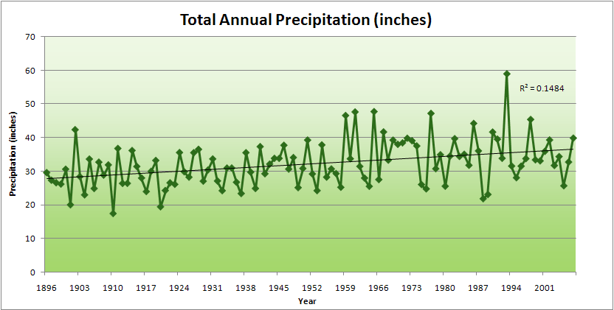
Cedar Rapids Data

Slide 15
Cedar Rapids Data
28.0”
32% increase
37.0”

Slide 16
Cedar Rapids Data
Years with more than 40 inches
11
1
28.0”
32% increase
37.0”

Slide 17
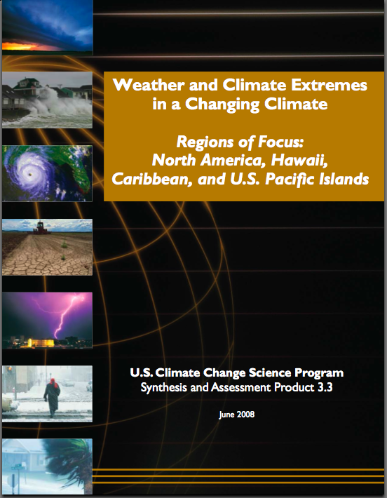
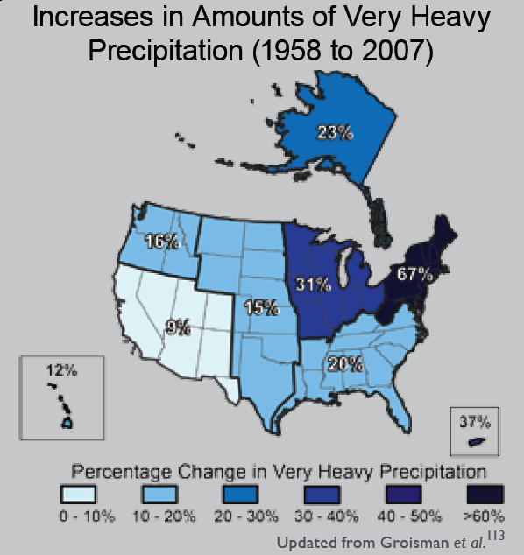
“One of the clearest trends in the United States observational record is an increasing frequency and intensity of heavy precipitation events… Over the last century there was a 50% increase in the frequency of days with precipitation over 101.6 mm (four inches) in the upper midwestern U.S.; this trend is statistically significant “
Karl, T. R., J. M. Melillo, and T. C. Peterson, (eds.), 2009: Global Climate Change Impacts in the United States. Cambridge University Press, 2009, 196pp.

Slide 18
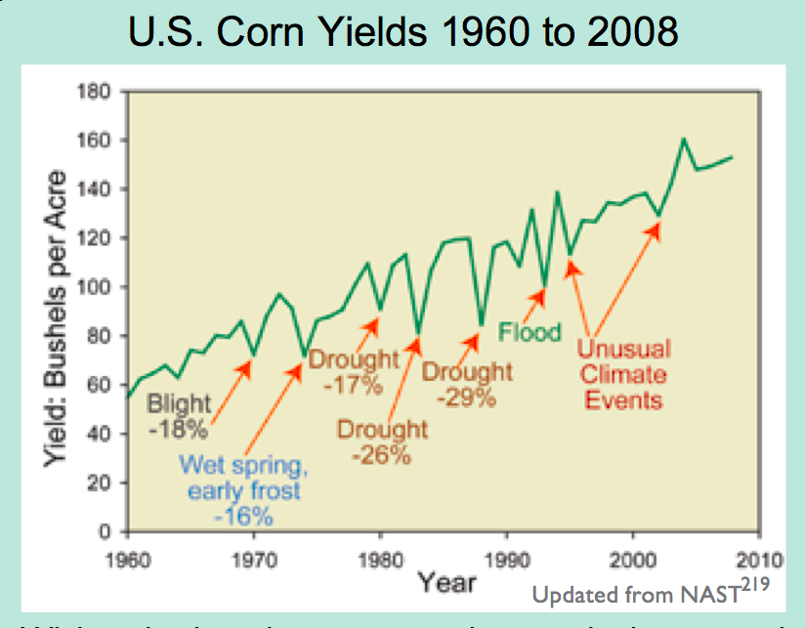
Extreme Events are Usually Detrimental

Slide 19
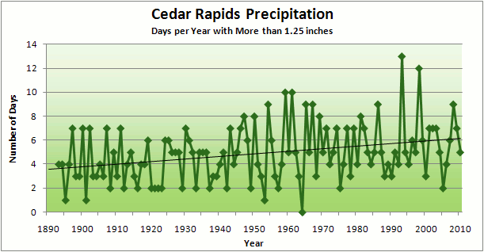
Cedar Rapids Data
3.6 days
67% increase
6.0 days

Slide 20
Cedar Rapids Data
Number of Years with More than 8 Occurrences: 0 => 9
0
9
3.6 days
67% increase
6.0 days

Slide 21
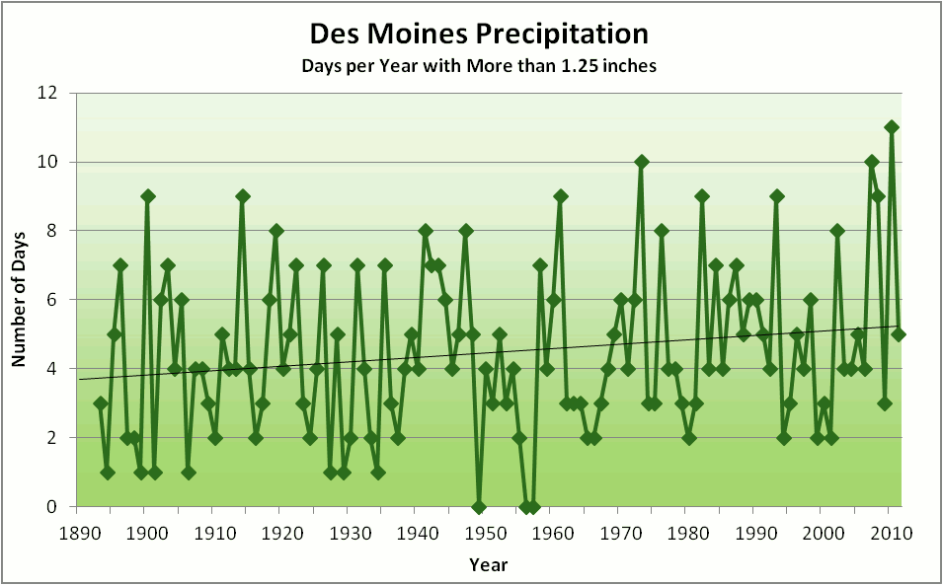
Number of Years with More than 8 Occurrences: 2 => 7
2
7
5.2 days
3.8 days
37% increase

Slide 22
Estimates for Future Numbers of Days Per Year With Precipitation Exceeding 1.25”
Based on the Gumbel Extreme Value Distribution using data from 1991-2010 assuming a stationary climate over that period.
Return Periods for Years With X Days Having > 1.25”
w 10% incr mean
12 days 6.5 y 6 y
15 days 11 y 9 y
20 days 29 y 22 y
22 days 42 y 30 y

Slide 24
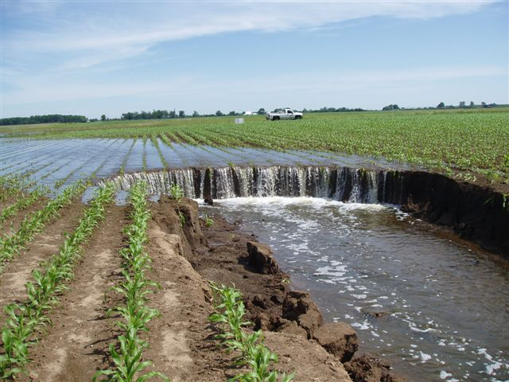
Photo courtesy of RM Cruse

Slide 25
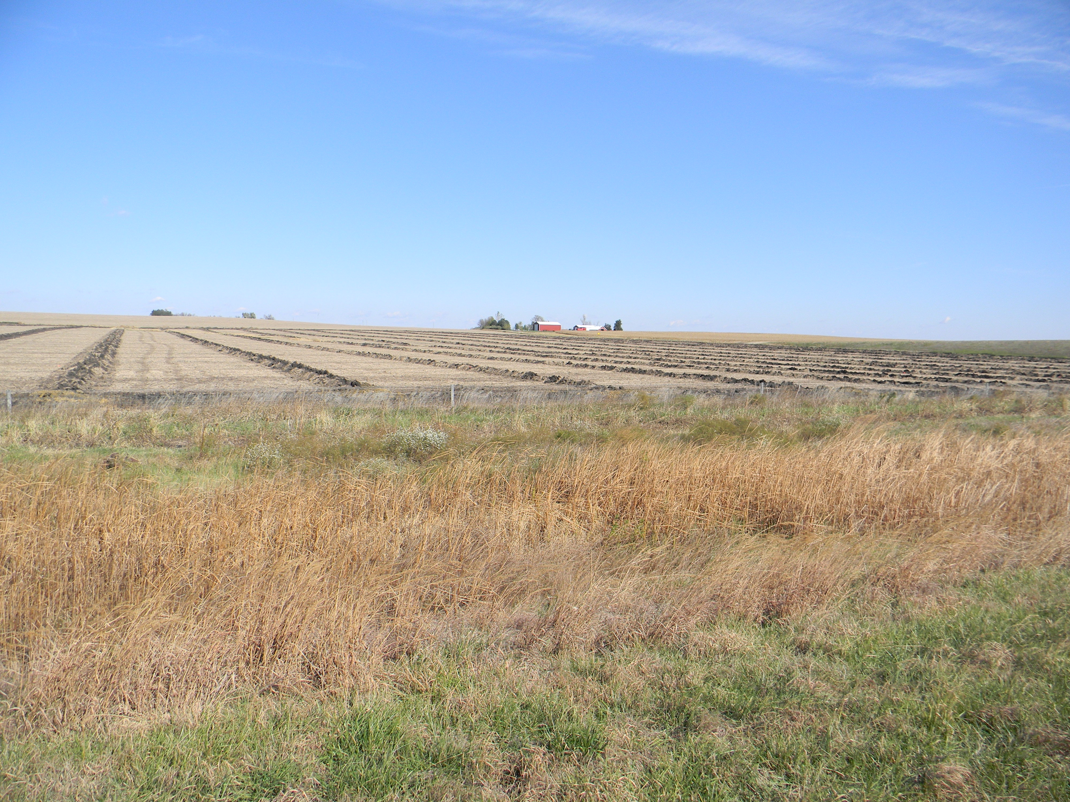

Slide 26
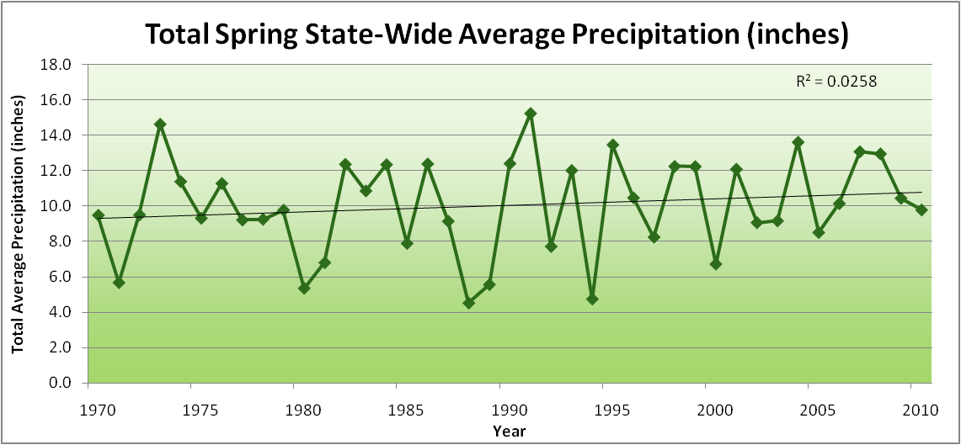
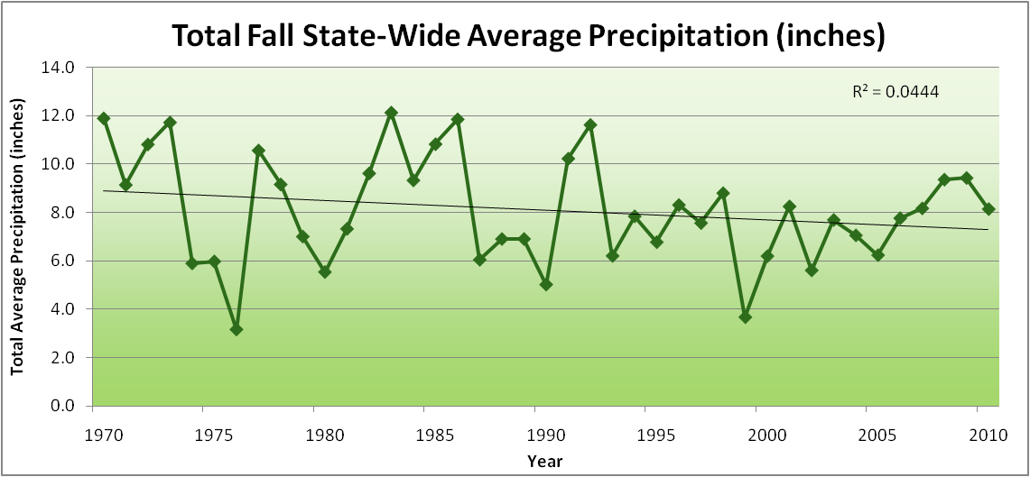
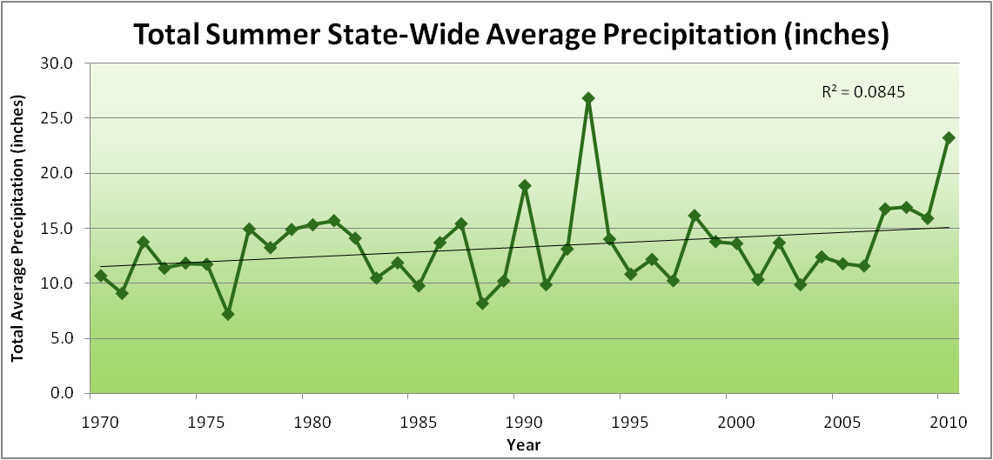
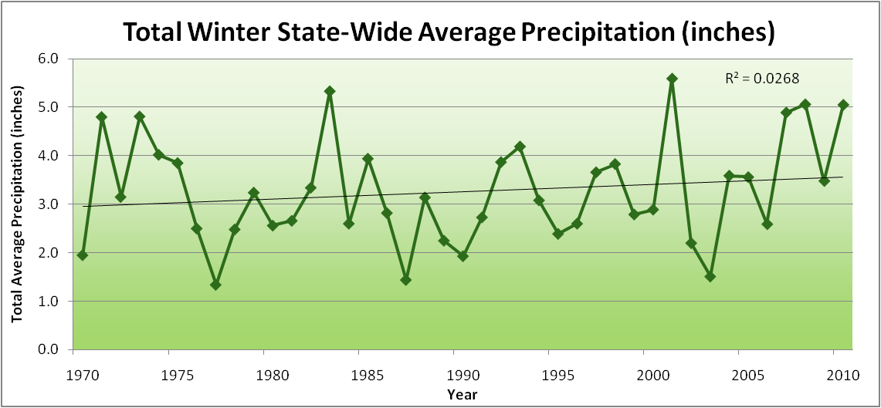
Amplification of the Seasonality of Precipitation
Spring
Fall
Summer
Winter

Slide 27
Amplification of the Seasonality of Precipitation
Spring
Fall
Summer
Winter

Slide 28
Amplification of the Seasonality of Precipitation
Spring
Fall
21.2 => 25.3 inches (22% increase)
12.1 => 10.5 inches (13% decrease)
Summer
Winter

Slide 29
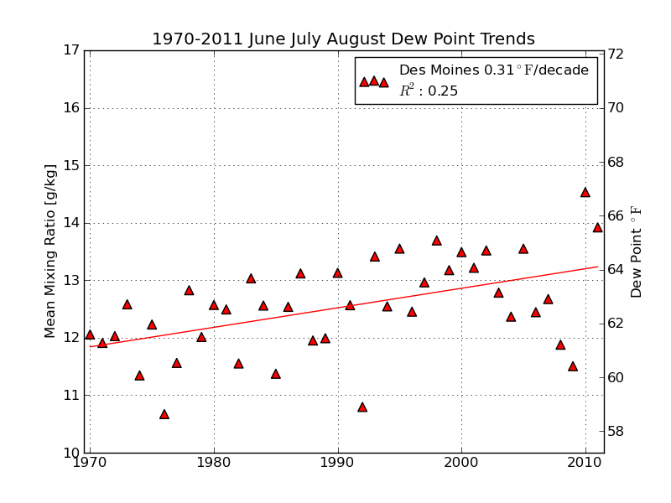
Mean Summer (JJA) Dew-Point Temperatures for Des Moines, IA
Rise of 3ºF in 42 years
12% rise in water content in 42 years

Slide 30
Iowa Agricultural Producers are Adapting to Climate Change:
Longer growing season: plant earlier, plant longer season hybrids, harvest later
Wetter springs: larger machinery enables planting in smaller weather windows
More summer precipitation: higher planting densities for higher yields
Wetter springs and summers: more subsurface drainage tile is being installed, closer spacing, sloped surfaces
Fewer extreme heat events: higher planting densities, fewer pollination failures
Higher humidity: more spraying for pathogens favored by moist conditions. more problems with fall crop dry-down, wider bean heads for faster harvest due to shorter harvest period during the daytime.
Drier autumns: delay harvest to take advantage of natural dry-down conditions, thereby reducing fuel costs
HIGHER YIELDS!!
Is it genetics or climate? Likely some of each.

Slide 31
Can we trust climate models for projecting future climate in the Midwest?
What is their record so far?
NASA GISS model from 1988 projected for Iowa:
Winters will warm more than summers (true)
Nights will warm more than days (true)
Precipitation will increase (true, but probably just lucky)
Shift in precipitation seasonality toward more in the first half year and less in the second half (true)
Takle, E. S., and S. Zhong, 1991: Iowa’s climate as projected by the global climate model of the Goddard Institute for Space Studies for a doubling of atmospheric carbon dioxide. Journal of the Iowa Academy of Science 98 (4), 153-158.

Slide 32
So what about droughts in the future?

Slide 33
Iowa State-Wide Average Data
Totals above 40”
2 years
8 years
34.0”
10% increase
30.8”

Slide 34
Iowa State-Wide Average Data
Totals above 40”
2 years
8 years
3 years
5 years
2012?
Totals below 25”

Slide 35
Cedar Rapids Data
Number of Years with More than 8 Occurrences: 0 => 9
Number of Years with Less than 3 Occurrences: 13 => 5
0
9
13
5
22

Slide 36
Number of Years with More than 8 Occurrences: 2 => 7
Number of Years with Less than 3 Occurrences: 16 => 9
2
7
16
9

Slide 37
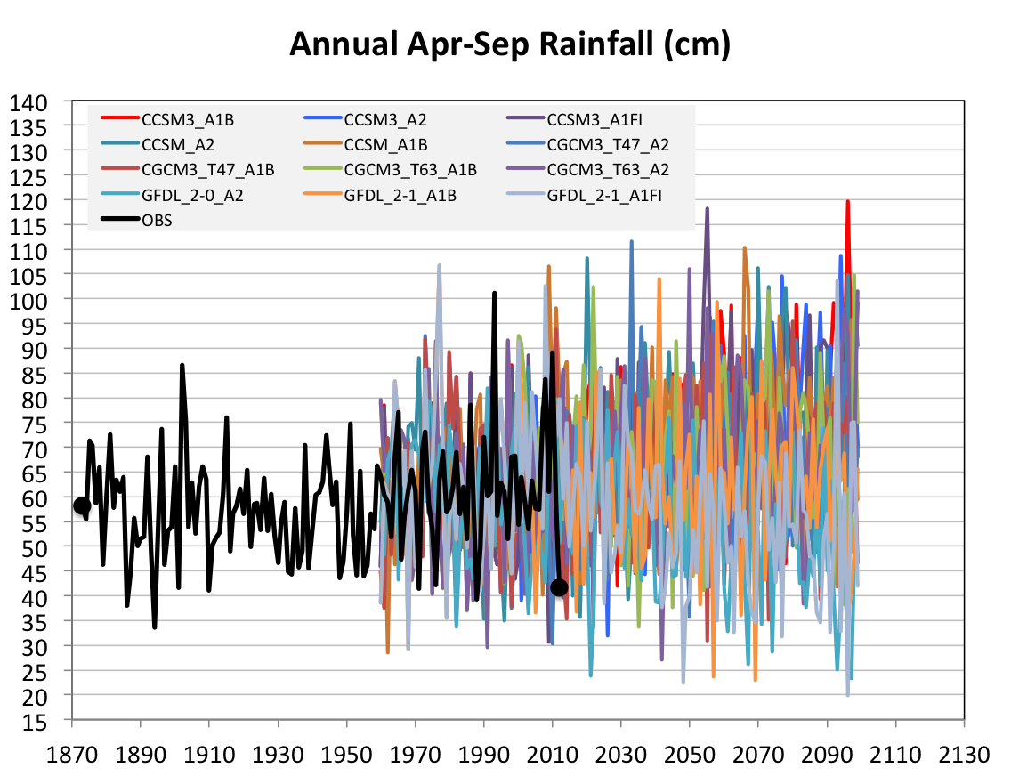
Future Variability in Growing Season Precipitation for Iowa
More extreme floods
More extreme droughts
CJ Anderson, ISU

Slide 38
Future Variability in Growing Season Precipitation for Iowa
More extreme floods
Lines drawn by eye
More extreme droughts
CJ Anderson, ISU

Slide 39
Can we trust climate models for projecting future climate in the Midwest?
What is their record so far?
NASA GISS model from 1988 projected for Iowa:
Winters will warm more than summers (true)
Nights will warm more than days (true)
Precipitation will increase (true, but probably just lucky)
Shift in precipitation seasonality toward more in the first half year and less in the second half (true)
Takle, E. S., and S. Zhong, 1991: Iowa’s climate as projected by the global climate model of the Goddard Institute for Space Studies for a doubling of atmospheric carbon dioxide. Journal of the Iowa Academy of Science 98 (4), 153-158.

Slide 40
Summary
Climate of the Midwest has an underlying warming in all seasons
Higher precipitation of the last 40 years has suppressed daily max temperatures in summer; dry summers in the future will unmask this underlying warming
Frequency of precipitation extremes has increased
Future projections indicate higher frequency of both floods and droughts

Slide 41
For More Information:
Climate Science Program
Iowa State University
http://climate.engineering.iastate.edu/
http://www.meteor.iastate.edu/faculty/takle/
gstakle@iastate.edu

Slide 42
Extra Stuff

Slide 43
Impacts of Climate Change on Animal Agriculture
Decreased weight gain in meat animals
Decreased egg production in poultry operations
Decreased milk production in dairy operations
Decreased breeding success in animal agriculture
Increase in sickness and disease

Slide 44
Results of Iowa Extension Service Annual Farm Survey*
2011 Iowa Farm and Rural Life Poll, an annual survey of Iowa farmers: 1,276 farmers
While 68% of Iowa farmers believe climate change is occurring, less than 45% believe humans are at least half responsible. Because of this a majority of farmers see little need to mitigate the causes of climate change.
Majority (53%) of Iowa farmers consider agriculture extension to be a trusted source of information on climate change
Less than a majority (41%) trust scientists on climate change (although scientists are second to extension personnel as a trusted source)
*https://store.extension.iastate.edu/ItemDetail.aspx?ProductID=13717

Slide 45
Results of Iowa Extension Service Annual Farm Survey*
2011 Iowa Farm and Rural Life Poll, an annual survey of Iowa farmers: 1,276 farmers
While 68% of Iowa farmers believe climate change is occurring, less than 45% believe humans are at least half responsible. Because of this a majority of farmers see little need to mitigate the causes of climate change.
Majority (53%) of Iowa farmers consider agriculture extension to be a trusted source of information on climate change
Less than a majority (41%) trust scientists on climate change (although scientists are second to extension personnel as a trusted source)
*https://store.extension.iastate.edu/ItemDetail.aspx?ProductID=13717

Slide 46
Results of Iowa Extension Service Annual Farm Survey*
2011 Iowa Farm and Rural Life Poll, an annual survey of Iowa farmers: 1,276 farmers
While 68% of Iowa farmers believe climate change is occurring, less than 45% believe humans are at least half responsible. Because of this a majority of farmers see little need to mitigate the causes of climate change.
Majority (53%) of Iowa farmers consider agriculture extension to be a trusted source of information on climate change
Less than a majority (41%) trust scientists on climate change (although scientists are second to extension personnel as a trusted source)
As climate change intensifies and adaptation
becomes more of a challenge,
producers will look to USDA for help
*https://store.extension.iastate.edu/ItemDetail.aspx?ProductID=13717

Slide 47
Related Activities
Climate and Corn-based Cropping System CAP (CSCAP). USDA NIFA project 2011-68002-30190. http:/www.sustainablecorn.org: developing science-based knowledge (on carbon, nitrogen, and water) that addresses climate mitigation and adaptation, informs policy development, and guides on-farm, watershed level and public decision making in corn-based cropping systems
Useful to Usable (U2U): Transforming Climate Variability and Change Information for Cereal Crop Producers. USDA NIFA project 2011-68002-30220. http:/www.AgClimate4U.org: Improving the resilience and profitability of farms amid variable climate changes by providing stakeholders with enhanced decision support tools

Slide 48
Climate-Informed Decision Cycle: Example - Corn Production in the Midwest
Draft Version
E.S. Takle

